Slide 1
MySQL and Assignment

Slide 2
Areas of focus
Creating database
Writing SQL query and execution
SQL query debugging
Creating EER Diagram
Understanding relationships
Identifying primary and foreign key

Slide 3
Task 1: List the different types of relationships in relational databases and provide examples.

Slide 4
Task 2: What is Normalization and why is it important to database development?

Slide 5
Database
You will work on with “world” database from mysql website resources. Please refer to the link to learn more about this database.
Link: https://dev.mysql.com/doc/world-setup/en/
Please read Preface and Legal Notices.

Slide 6
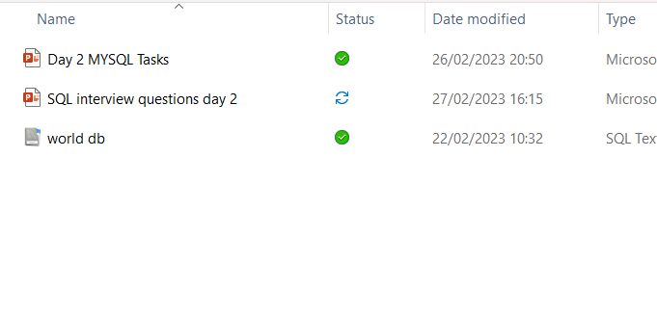
Download Database SQL Script
You can find database in Teams files.

Slide 7
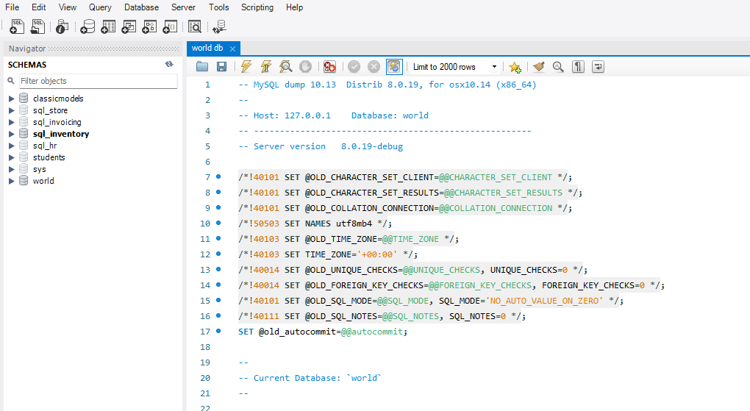

Import and Execute
Import SQL Script “world db” and then execute the script. Refresh schemas and check if db “world” exits.

Slide 8
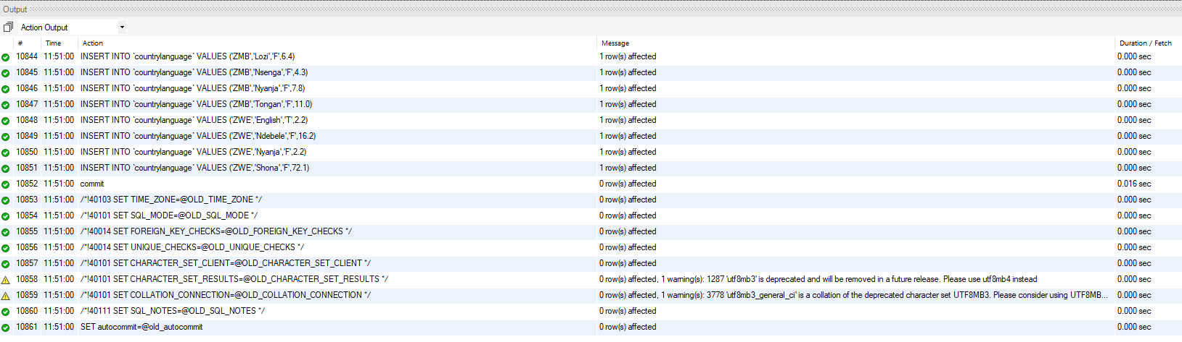
Once executed you will see the below actioned Output

Slide 9
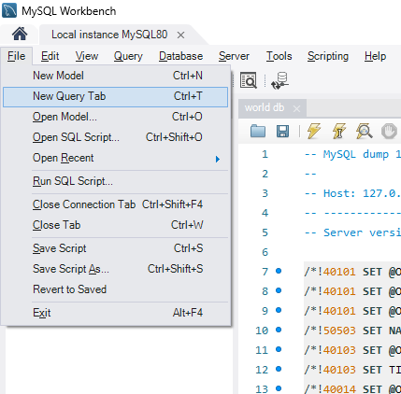
New Query Tab
On your keyboard hold down Ctrl and T keys to open new query tab.
Or you can do it from task bar

Slide 10
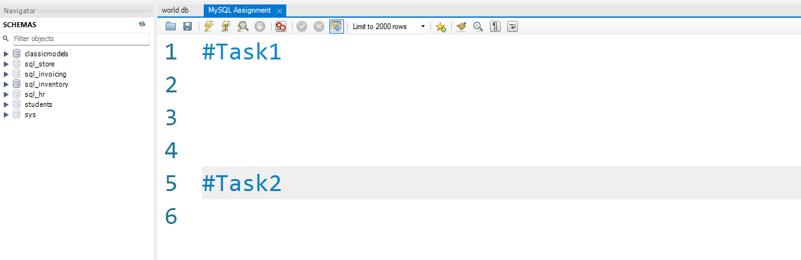
Saving Task and Queries
Use # key to comment your tasks. You will need to save this query tab for trainers review later. Please use same query tab for all your tasks.

Slide 11
Task 3
Using count, get the number of cities in the USA

Slide 12
Task 4
Find out what the population and life expectancy for people in Argentina (ARG) is

Slide 13
Task 5
Using ORDER BY, LIMIT, what country has the highest life expectancy?

Slide 14
Task 6
Select 25 cities around the world that start with the letter 'F' in a single SQL query.

Slide 15
Task 7
Create a SQL statement to display columns Id, Name, Population from the city table and limit results to first 10 rows only.

Slide 16
Task 8
Create a SQL statement to find only those cities from city table whose population is larger than 2000000.

Slide 17
Task 9 (Optional)
Create a SQL statement to find all city names from city table whose name begins with “Be” prefix.

Slide 18
Task 10 (Optional)
Create a SQL statement to find only those cities from city table whose population is between 500000-1000000.

Slide 19
Task 11 (Optional)
Create a SQL statement to find a city with the lowest population in the city table.

Slide 20
Task 12 (Optional)
Create a SQL statement to show the population of Switzerland and all the languages spoken there.

Slide 21
Task 13: Creating an EER Diagram

Slide 22
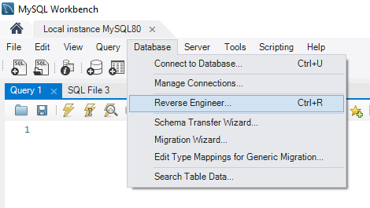

Slide 23
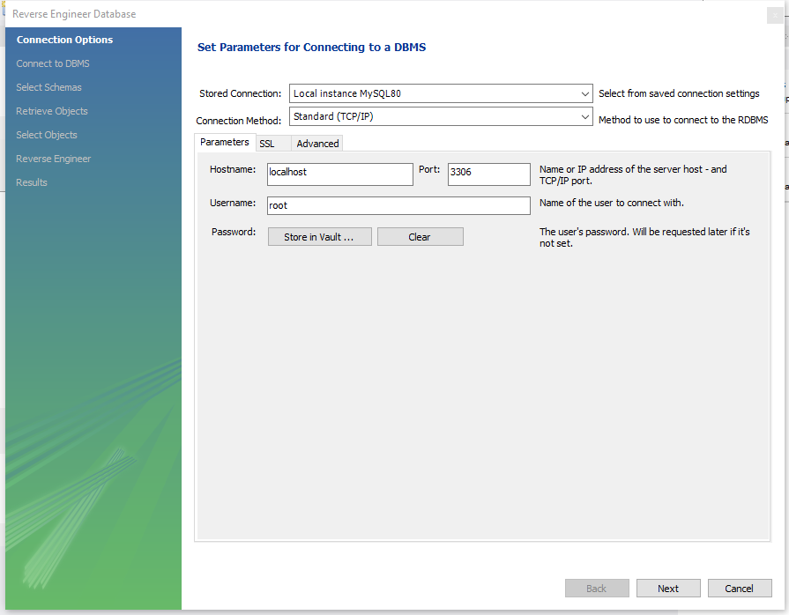

Slide 24
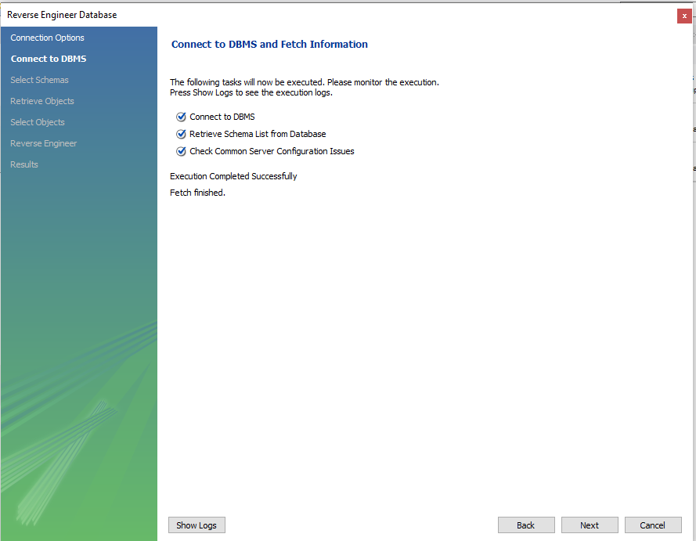

Slide 25
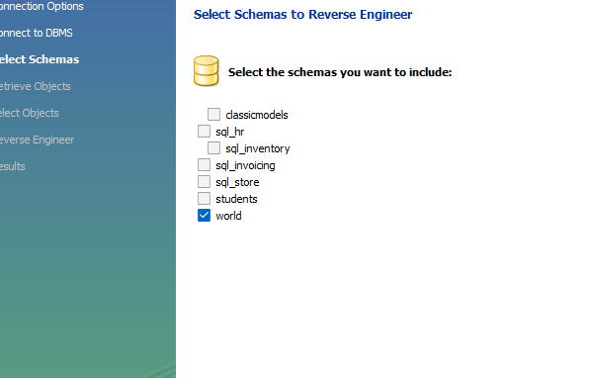
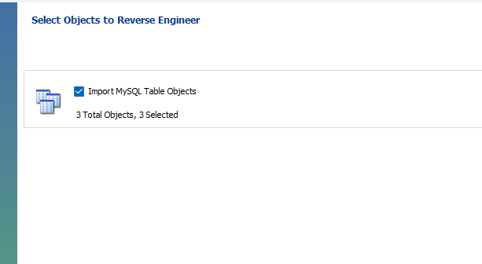

Slide 26
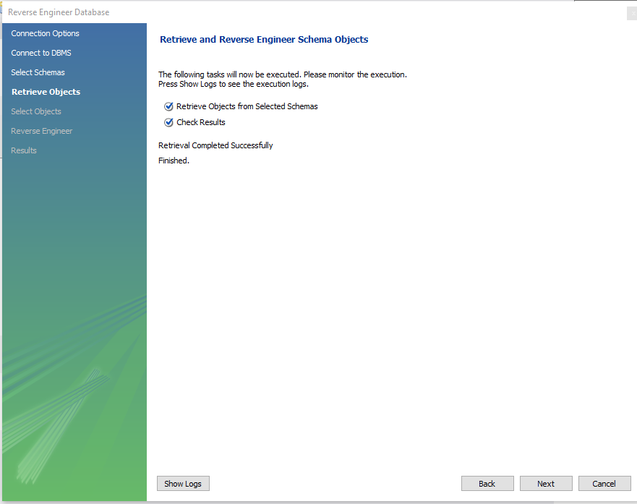

Slide 27
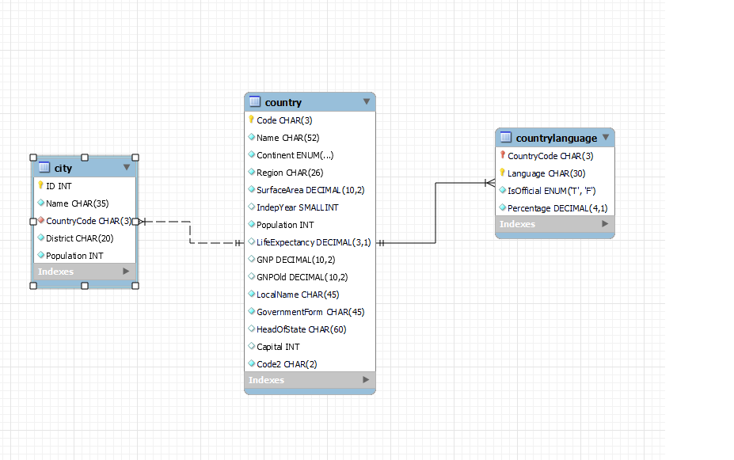

Slide 28
Task 14
Create a MS Word file name it as - Name for your answers.
Identify the primary key in country table.
Identify the primary key in city table.
Identify the primary key in countrylanguage table.
Identify the foreign key in city table.
Identify the foreign key in countrylanguage table.

